Slide 1
Moving data. Powering your data lakes.

Slide 2
Agenda
1
Why data lake architectures?
Problems with unmanaged data lakes
How Fivetran does data lakes better
Fivetran Managed Data Lake Service
Fivetran data lake destinations
Resources
2
3
4
5
6

Slide 3
Why data lake architectures?
Inexpensive and scalable
ML and AI ready
Modular
Flexible architecture
Notes:
There are a lot of destinations for your data - but not all of them are created equal. Data lakes, in particular, have a few areas where they really shine - and would lead folks to select them over let’s say a traditional cloud warehouse.
For example:
If you are looking for storage that tends to be very inexpensive and scalable, data lakes might be your best option.
Object storage is incredibly cheap and scales out infinitely. 1 TB of data costs ~$23.55/month on AWS S3.
ML- and AI-ready: Data lakes can store any kind of data – structured data (tables), semi-structured data (e.g. JSON), and unstructured data (images/ videos/ documents/ raw files), which is often needed for machine learning and AI applications. CDWs don't typically support unstructured data.
Modular: Any layer of the data analytics stack can be switched out for a better tool at any point. Switching to a new compute engine, data catalog, data cloud, or CI/CD tool is easy.
Flexible architecture: "Write once, read many" – can read data directly from the lake with any compatible compute layer / query engine. Multiple users and tools can operate on the bare metal data at once.

Slide 4
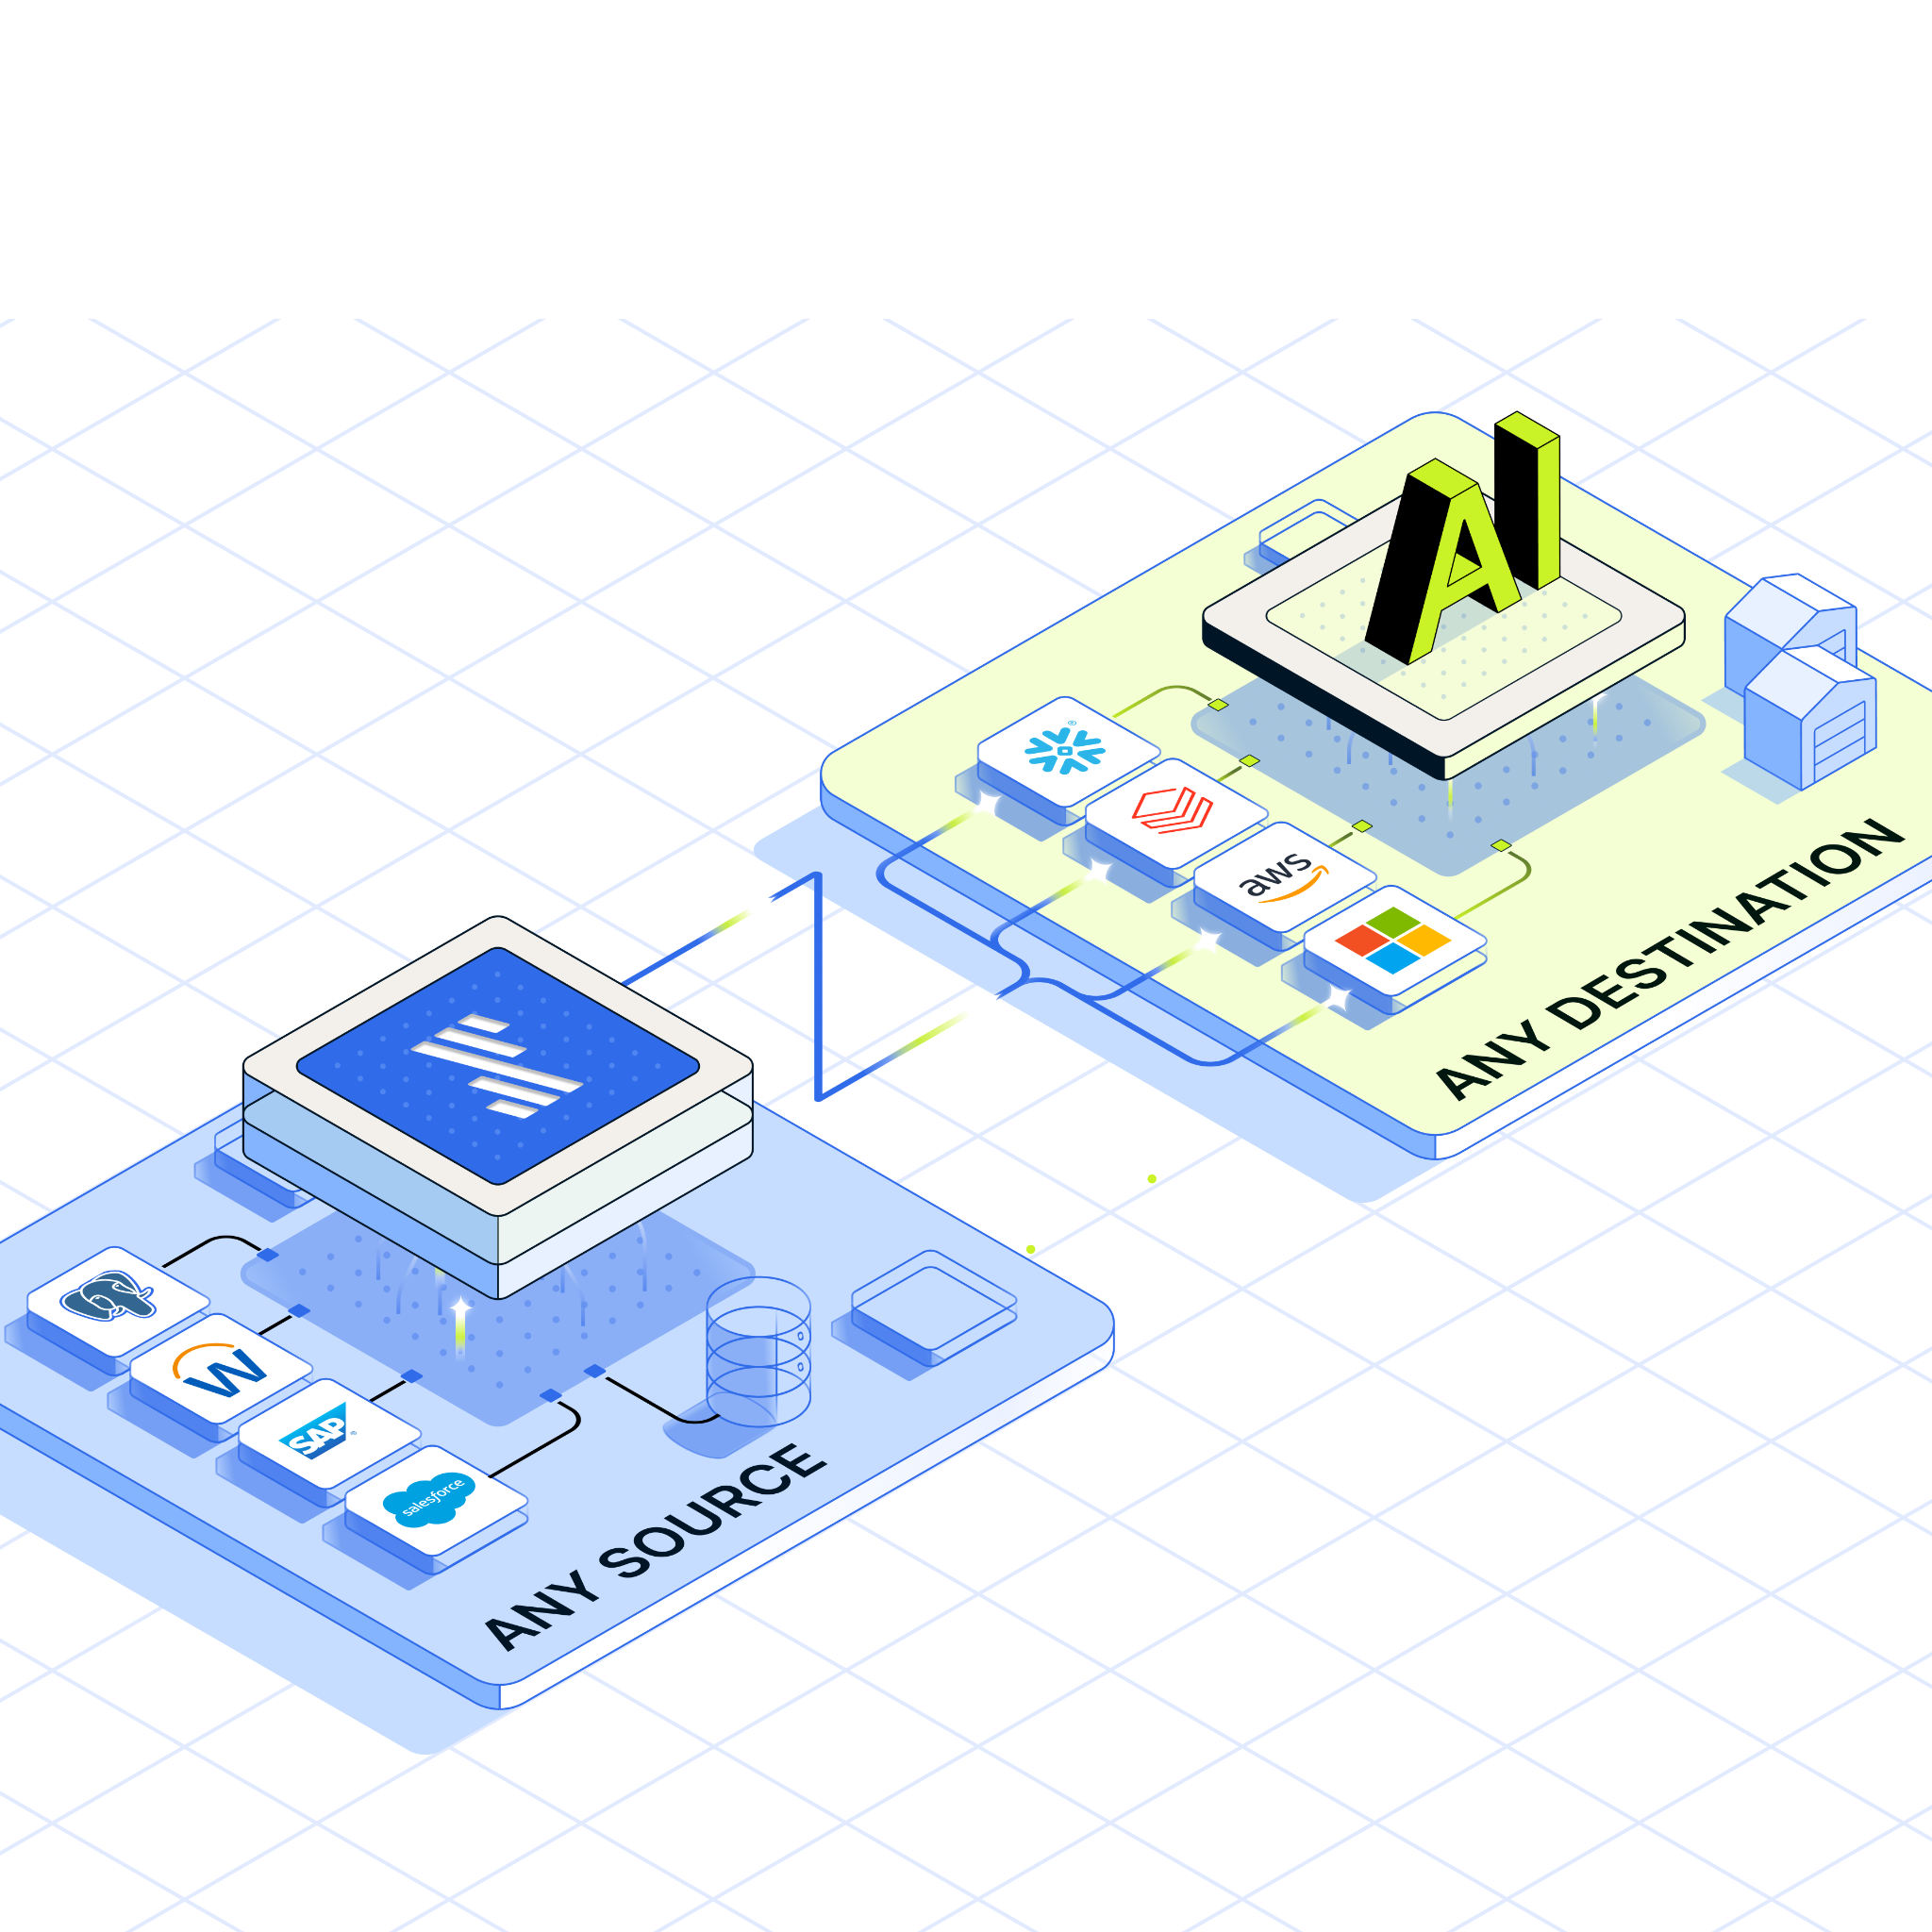
Why are data lakes essential for AI/ML?
Artificial intelligence & machine learning have reached a tipping point.
Data warehouses offer limited support for the unstructured and semi-structured text data needed for ML and AI large language models.
Companies have looked to data lakes as a potential solution, but early attempts floundered due to the difficulty of managing so many different kinds of data at massive scale.
Notes:
AI & machine learning have reached a tipping point. These fields have progressed far enough that they are achieving results that were not possible in the past. Companies are seeing the potential business impact that applying ML can have, and want to take advantage of it.
But traditional data warehouses are simply not designed for serious ML & AI practitioners to build models and applications. They offer limited support for the unstructured and semi-structured text data needed to build machine learning and AI/large language models.
So, for years companies have looked to data lakes as a potential solution. They enable users to store any kind of data, including unstructured and semi-structured data that is essential for building AI applications.
But early attempts at data lakes flopped due to difficulty managing so many different kinds of data at massive scale.

Slide 5
Problems with passively-managed data lakes
Difficult to enforce data governance, compliance, and data quality
Manual data management, change data capture and table maintenance
Complex, brittle, insecure data integration pipelines
Notes:
Difficult to enforce data governance, compliance, and data quality:
Need simple way to enable Updates/merges/deletes for GDPR compliance
Need metadata tagging for context and discoverability of relevant datasets
No way to enforce data quality and consistency → need to be able to set constraints or expectations on incoming data
No way to handle schema evolution
Need a standard data format to make it queryable right out of the box
Manual data management, change data capture and table maintenance:
Updates/merges/deletes must be performed all the time
Difficult to keep datasets up-to-date with new data streaming in constantly
Responsibility for data normalization, deduplication, compaction, pruning / deleting old files falls to the user, who must manage it constantly
Change data capture is an incredibly difficult task that must be performed flawlessly
Complex, brittle data integration pipelines:
Creating custom data pipelines from 10+ sources can be difficult and time consuming
DIY data pipelines into data lakes often have security issues that can expose data in motion
Keeping data pipelines up and running requires continuous maintenance and additional work
Upstream APIs and schemas change all the time with no warning, breaking manual data pipelines
Downtime can jeopardize organizational credibility and effectiveness

Slide 6
Without proper data governance, data lakes can quickly devolve into chaotic “data swamps.” Untagged, disorganized data becomes nearly impossible to use, rendering the data lake useless and wasting valuable storage space.
Jackie McGuire, Cribl 2024

Slide 7
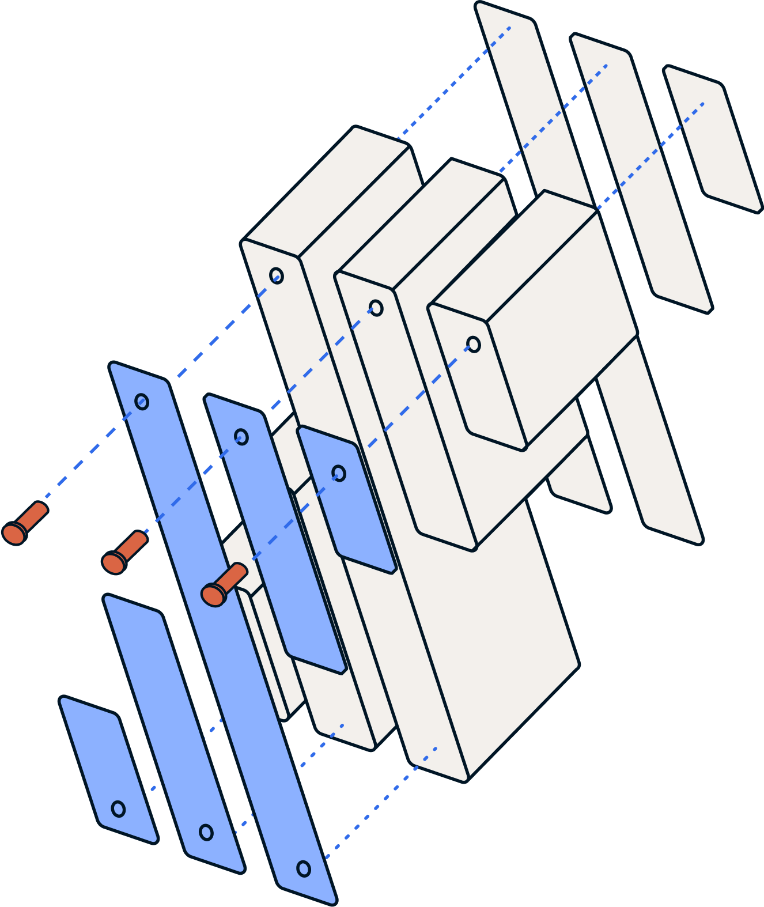
How does Fivetran do data lakes better?

Slide 8
Fivetran automatically creates an actively-managed data lake
Simple tools to enforce data governance, compliance, and data quality
Automatic data management, change data capture and table maintenance
Secure and reliable
data integration pipelines
Fivetran automatically converts your data to a standardized data lake format (Iceberg/Delta Lake) that provides ACID transactions, tools for data quality, GDPR compliance, and more.
Fivetran provides automated data management, including normalization, deduplication, compaction, and more, ensuring your data is up-to-date and ready to query at all times with no manual maintenance required.
Fivetran supports 500+ data source connectors with industry-leading uptime for worry-free, no-maintenance data replication. Our industry-leading compliance and security guarantees safeguard sensitive data.
Notes:
Difficult to enforce data governance, compliance, and data quality:
Need simple way to enable Updates/merges/deletes for GDPR compliance → Iceberg/Delta Lake offer simple tools to execute these transactionally.
Need metadata tagging for context and discoverability of relevant datasets → Iceberg/Delta Lake offer robust metadata tagging, plus are compatible with 3rd party catalogs
No way to enforce data quality and consistency → need to be able to set constraints or expectations on incoming data → Iceberg/Delta Lake can enforce constraints and expectations
No way to handle schema evolution → Iceberg/Delta Lake are built to handle schema evolution gracefully
Need a standard data format to make it queryable right out of the box → Fivetran automatically converts data to a standard format (Iceberg/Delta Lake)
Manual data management, change data capture and table maintenance:
Updates/merges/deletes must be performed all the time → managed data integration with no manual maintenance needed
Difficult to keep datasets up-to-date with new data streaming in constantly → Iceberg/Delta Lake support streaming data, and Fivetran integrates it with no manual maintenance needed
Responsibility for data normalization, deduplication, compaction, pruning / deleting old files falls to the user, who must manage it constantly → Fivetran automates all of these from end-to-end
Change data capture is an incredibly difficult task that must be performed flawlessly → Fivetran's managed solution handles CDC and ensures accurate data replication at all times
Complex, brittle data integration pipelines:
Creating custom data pipelines from 10+ sources can be difficult and time consuming → Fivetran offers 500+ data sources, and you can be up and running within minutes
DIY data pipelines into data lakes often have security issues that can expose data in motion → Fivetran's industry-leading compliance and security guarantees safeguard sensitive data.
Keeping data pipelines up and running requires continuous maintenance and additional work → Fivetran offers 99.9+% connector uptime - no pager going off because of a broken pipeline at 2 AM
Upstream APIs and schemas change all the time with no warning, breaking manual data pipelines → Fivetran offers 99.9+% connector uptime, and handles schema evolution gracefully.
Downtime can jeopardize organizational credibility and effectiveness → Fivetran offers 99.9+% connector uptime

Slide 9


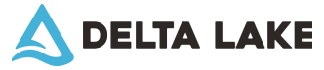
Fivetran converts your data to Iceberg or Delta Lake table formats, enabling CDW-like functionality on the data lake
Issues with ordinary Parquet | Iceberg / Delta Lake solution
Lack of transactions | ACID transactions
No support for schema evolution (adding or removing columns over time) | Built-in support for schema evolution
No data versioning support | Transaction log enables data versioning / "time travel", auditability
No support for upserts and deletes | Simple API and SQL commands for upserting and deleting data
Difficulty managing data quality and governance | Support for data quality tools, constraints and expectations
Fragmented data and the "small files" problem | Compaction and optimization features like bin-packing and Z-ordering
Notes:
Fivetran automatically converts customer data to the Iceberg or Delta Lake formats, which are specifically designed to provide data warehouse like functionality on the data lake. By doing so, we standardize your data, no matter what its original source or data type – and once it's in a universal format, it's queryable right out of the box.

Slide 10
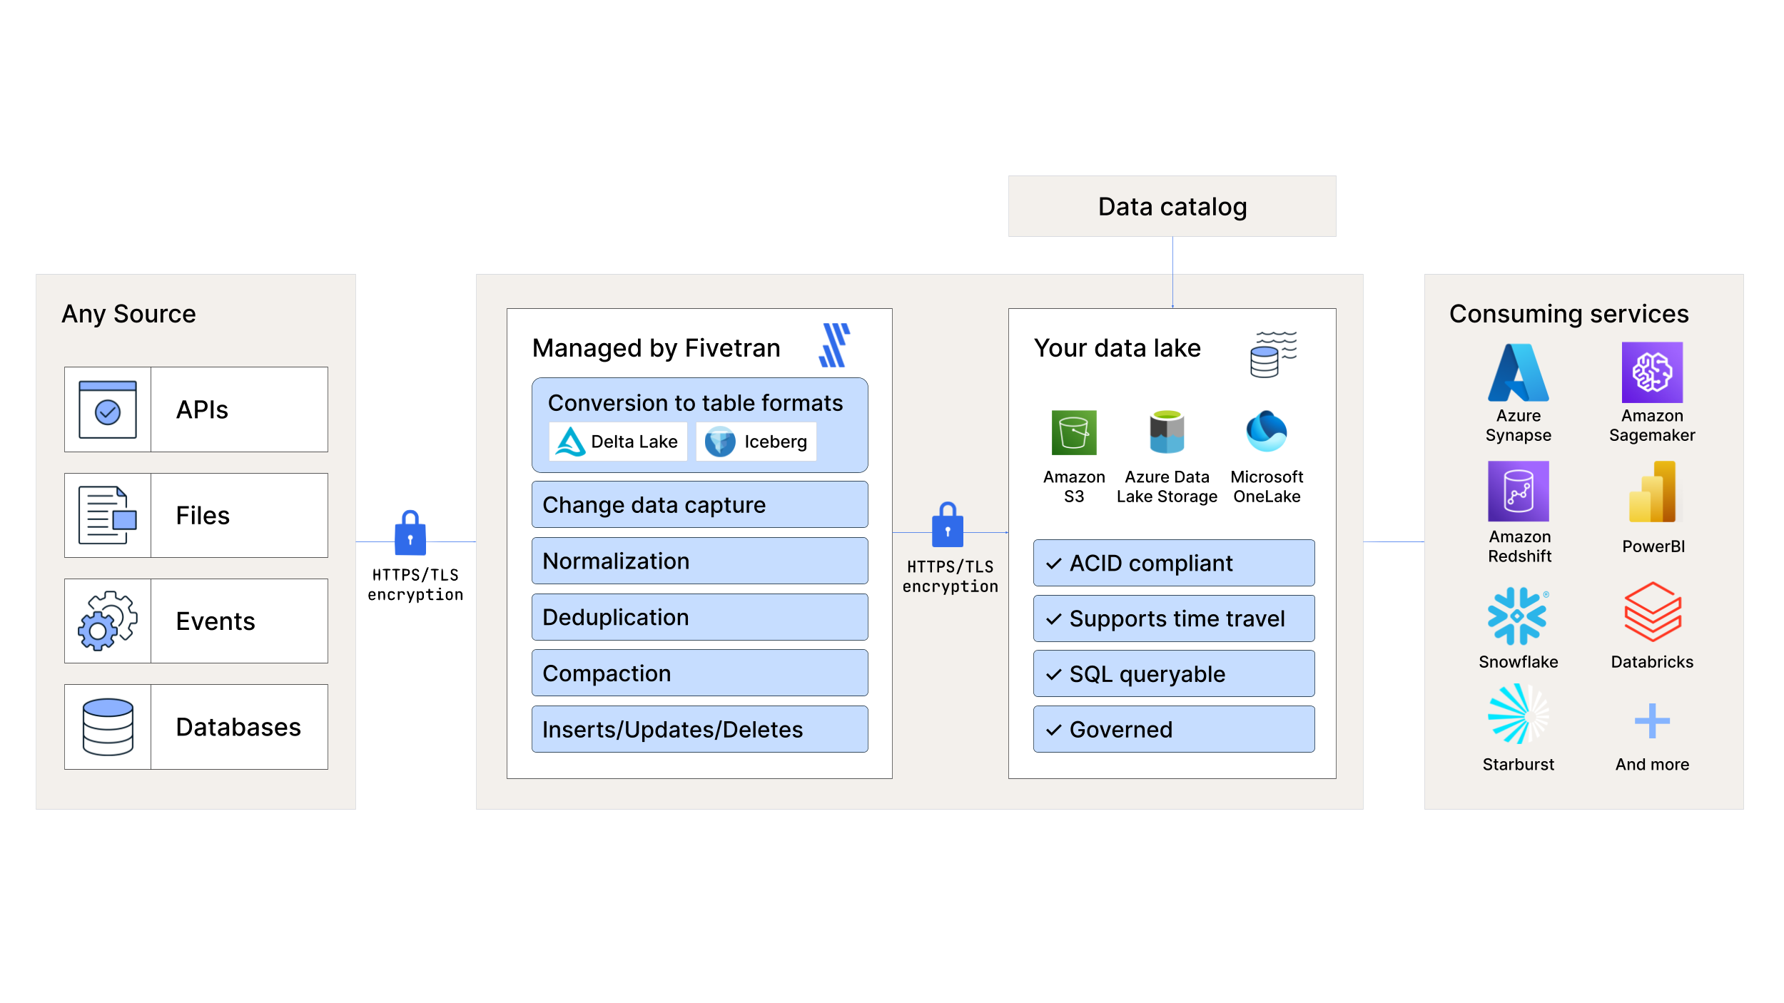
Introducing Fivetran Managed Data Lake Service for building governed data lakes
Move data from over 500 supported data sources.
Fivetran converts your data to Delta Lake or Iceberg.
Native integration with cloud data catalogs.
Build an open data lake house architecture based on standard, interoperable formats supported by all major cloud data platforms.
Notes:
EXISTING DATA LAKES ARE SUPPORTED
Move data from over 500 supported data sources, including databases, on-prem and cloud data warehouses, SaaS applications, events, and files into the data lake.
Automated data processing ensures that data arrives clean, conformed, normalized, and de-duplicated. Data arrives consistent, complete, and up-to-date at all times, even as change data streams in.
Automatically convert your data to Delta Lake or Iceberg format, before landing it in the lake. These formats ensure your data is instantly query-ready, and offer tools for simple data governance.
Native integration with cloud data catalogs like AWS Glue, Microsoft Purview, Google Data Catalog and others enables tables to appear instantly and automatically.

Slide 11






Support for major data lake destinations
Amazon S3 + Iceberg
Azure Data Lake Storage + Delta Lake
Databricks + Delta Lake
Amazon S3 + Delta Lake
private preview
Microsoft OneLake + Delta Lake
Load data to a structured, governed data lake with Iceberg or Delta Lake.
Notes:
According to Gartner, 55% of organizations have plans to use generative AI and 78% of executives believe the benefits of AI adoption outweigh the risks. In order to store the large volumes of data needed to power LLM, Fivetran supports data lake destinations. Securely and reliably centralize large volumes of data from a wide range of text-rich sources into a cloud data warehouse or data lake for the success of your AI/ML project. Fivetran support S3 Iceberg and Azure Data Lake as destinations for you to load your structured and semi-structured data.

Slide 12
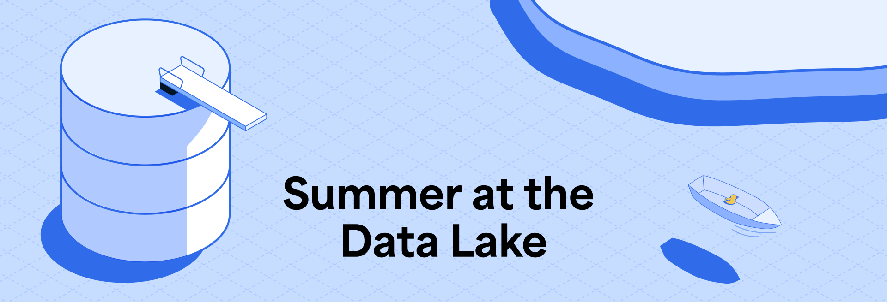
Make a big splash this summer into the Fivetran Managed Data Lake Service.
New to data lake destinations? Set up pipelines to load data to Amazon S3, Azure Data Lake Storage or Microsoft OneLake and get free usage in June, July, and August.
Already using a data lake destination? We have some premium offers available to customers already benefiting from our managed data lake service and looking to grow their usage.
Notes:
You can get started with the Managed Data Lake Service by simply setting up a new data lake destination and loading data to it. No talking to sales, unless you want to! If you're already using Fivetran's data lakes, new connections to the lake will be free for the duration of the promotion.
Terms and conditions for the promotion can be found on the blog post announcing the Managed Data Lake Service.

Slide 13



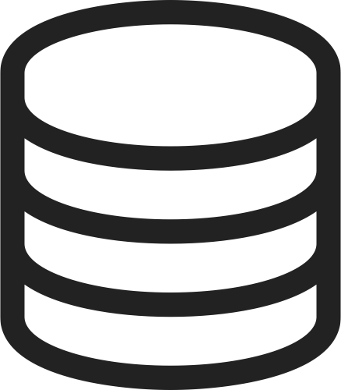

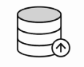






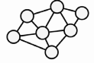




Fivetran’s Data Lake Destinations are a core component of the new AI stack
Sources
Data platform
User prompt
Applications
Gen AI & LLM
Databases
Data lakehouse
Events
Vector
database
Transformation
Retrieval
model
Foundation
model
Files
Knowledge
graph
Functions
Metadata to data catalog
Warehouses
Answers
Notes:
RAG: Retrieval Augmented Generation
So what does Fivetran have to do with generative AI? The answer is that Fivetran sits upstream of your workload and provides the critical data integration services that bring text-rich data into a singular destination.
The first few stages of this architecture are shared in common with more basic analytics use cases.
Step One: Securely and reliably centralize large volumes of data from a wide range of text-rich sources into a cloud data warehouse or data lake to power LLM.
Step Two: Metadata logging enables you to populate a data catalog, which enables you to populate a knowledge graph that encodes semantic information about your organization
Step Three: Textual data can be transformed into vectors and embedded in a vector database.
Step Four: Vectorized text data feeds retrieval augmented generation (RAG) built on top of a foundation model
What comes afterward is unique to generative AI. You can supplement an off-the-shelf generative AI model with your data in two ways:
The most important way is to turn long strings of text into enumerations and then store these in a vector database that your foundation model can access. This enables the generative AI to add your organization’s data to its long-term memory, enabling it to return meaningful results both from the general knowledge provided through its initial training and your organization’s unique data.
The second way piggybacks off of any data catalog you might construct for data governance. You can combine large language models with knowledge graphs, explicitly encoding semantic understanding into the model, not just statistical word associations.

Slide 14
Resources

Slide 15
Resources
Product pages
Data lakes & warehouses | Fivetran
Blogs
Fivetran supports Amazon S3 as a destination with Apache Iceberg | Blog
Building a Modern Data Lake with Fivetran and Amazon S3 to Accelerate Data-Driven Success | AWS Partner Network (APN) Blog
How to govern your S3 data lake | Blog | Fivetran
Iceberg in the modern data stack | Blog | Fivetran
Coupa accelerates its S3 Data Lake with Fivetran | Case Study
Press releases
Fivetran’s New Capabilities on Amazon S3 Support Generative AI
Fivetran Supports the Automation of the Modern Data Lake on Amazon S3
Resources
Whitepaper: Modernizing the Data Lake – How Fivetran Fuels Amazon S3 with Iceberg
One Pager: How data becomes generative AI
Webinars & Hands-On Labs
Hands-on Lab: Building a Better Data Lake using S3 and Fivetran + Iceberg
Documentation
Fivetran for S3 Data Lake
Fivetran for Azure Data Lake Storage
Fivetran for Databricks
Fivetran for OneLake

